Slide 1
Automating your CI/CD Stack with Java and Groovy
Jeanne Boyarsky & Scott Selikoff
Tuesday Oct 23, 2018
Oracle Code One – HOL4957
speakerdeck.com/boyarsky

Slide 2
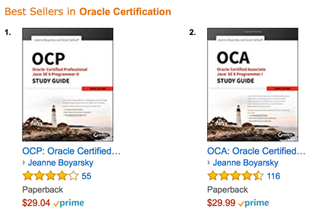
About Us
Combined
30+ years Java
15+ years tooling
10+ years Groovy
@jeanneboyarsky

Slide 3
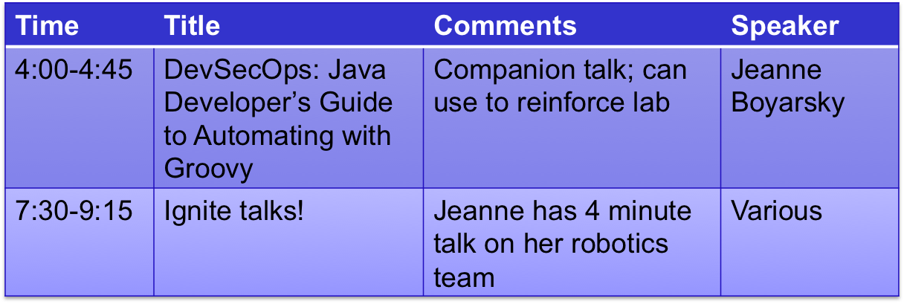
Tuesday More from Jeanne

Slide 4
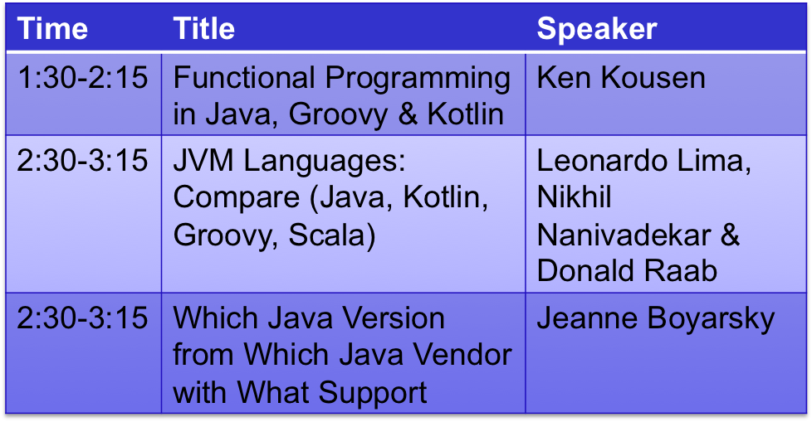
Wednesday Recommendations

Slide 5
What you’ll learn in the lab
Ways you can run Groovy in Nexus/Jenkins
Using object model APIs from Groovy
Configuring a custom Java Sonar rule
The initial steps in securing a system

Slide 6
Tools
HOL Network
Docker container
Docker container
Docker container
Nexus
Jenkins
Sonar
Binary repository
CI Engine
Static analysis

Slide 7
Docker
Stop
Run
Remove
Start

Slide 8
Other tools/languages
Groovy – JVM programming language
curl – command line (we use to test network connectivity)

Slide 9
One minute intro to Groovy
For this lab
Use Java if you don’t know Groovy
All Groovy code in solution guide for reference (or copy/paste)
Don’t waste time on Groovy syntax if don’t already know Groovy.
More on Groovy syntax at 4pm
Groovy
Java

Slide 10
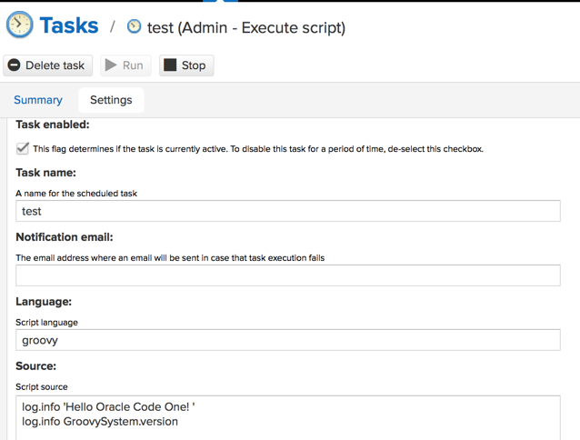
log.info'Hello Oracle Code One! ’
log.info GroovySystem.version

Slide 11
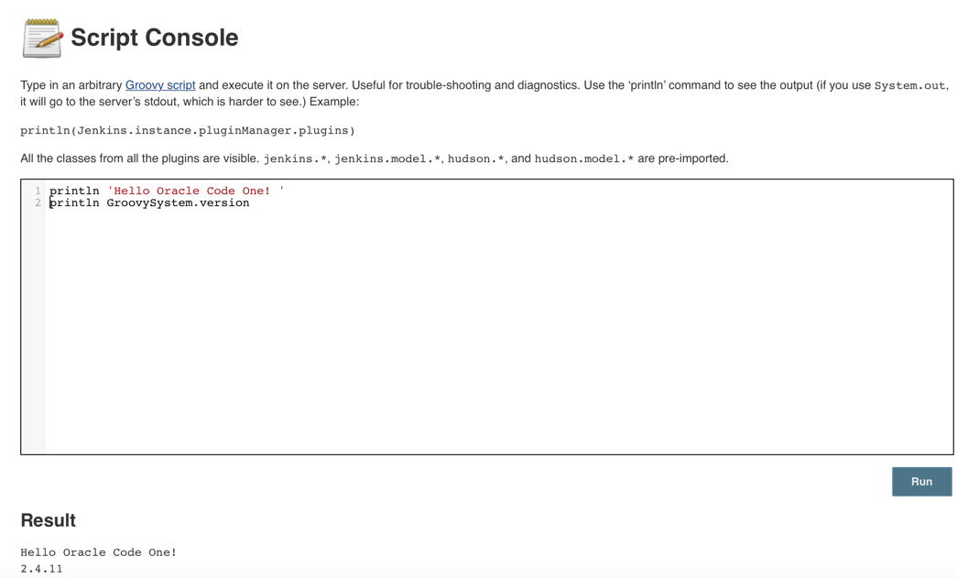
println 'Hello Oracle Code One! '
println GroovySystem.version
Hello Oracle Code One!
2.4.11

Slide 12
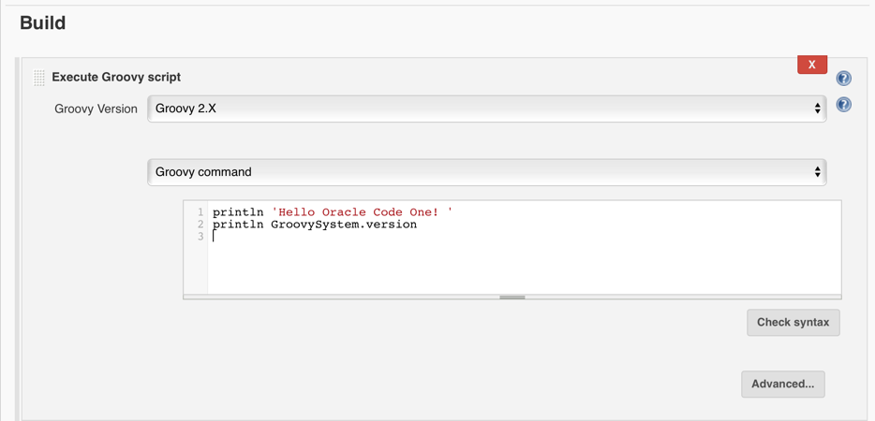

Slide 13
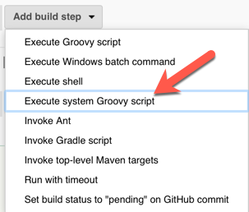
System scripts can access object model
Can’t choose
Groovy version

Slide 14
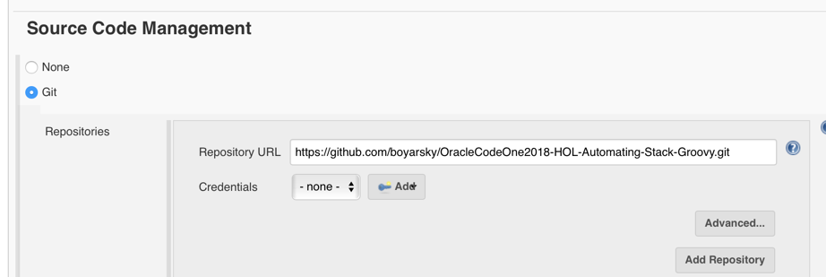
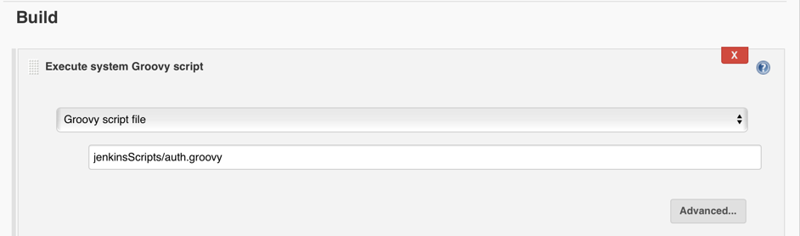

Slide 15
Script Security Plugin
ERROR: Build step failed with exception
org.jenkinsci.plugins.scriptsecurity.sandbox.RejectedAccessException: Scripts not permitted to use staticMethod jenkins.model.Jenkins getInstance
Options:
Approve each script manually
Sandbox - whitelist APIs
Authorized Build plugin to run as admin
Copy/paste Groovy code (we do this in the lab)

Slide 16
Flow
The lab is self paced
Raise your hand if you get stuck or have a question.
If there is a FAQ, we will demo it on the screen.

Slide 17

Let’s start!
On to the lab!
In a browser go to
https://github.com/boyarsky/OracleCodeOne2018-HOL-Automating-Stack-Groovy
Notes:
https://pixabay.com/p-154544/?no_redirect

